Slide 1

Programme for International Student Assessment
Welcome
PISA for Development
Andreas Schleicher
Special advisor to the Secretary-General on Education Policy
Head of the Indicators and Analysis Division, EDU

Slide 2
The motivation for PISA
  In a global economy, the yardstick for success in education is no longer improvement by national standards alone, but the most rapidly improving school systems internationally

Slide 3
The idea of PISA
  Measuring educational progress within an internationally agreed framework to provide a basis for international collaboration
  on designing and implementing educational policies
    Show countries what achievements are possible
    Help governments set policy targets in terms of measurable goals achieved elsewhere
    Gauge the pace of educational progress
    Facilitate peer-learning on policy and practice

Slide 4
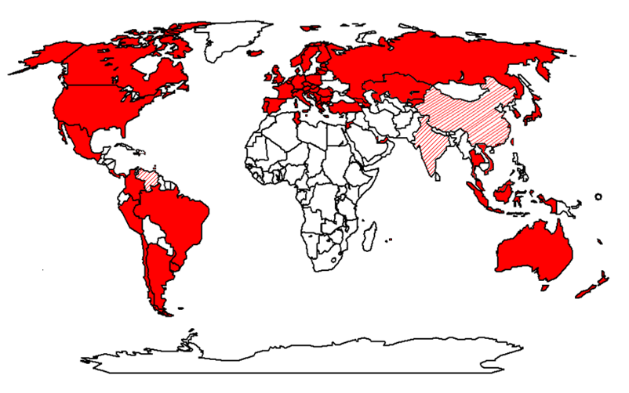
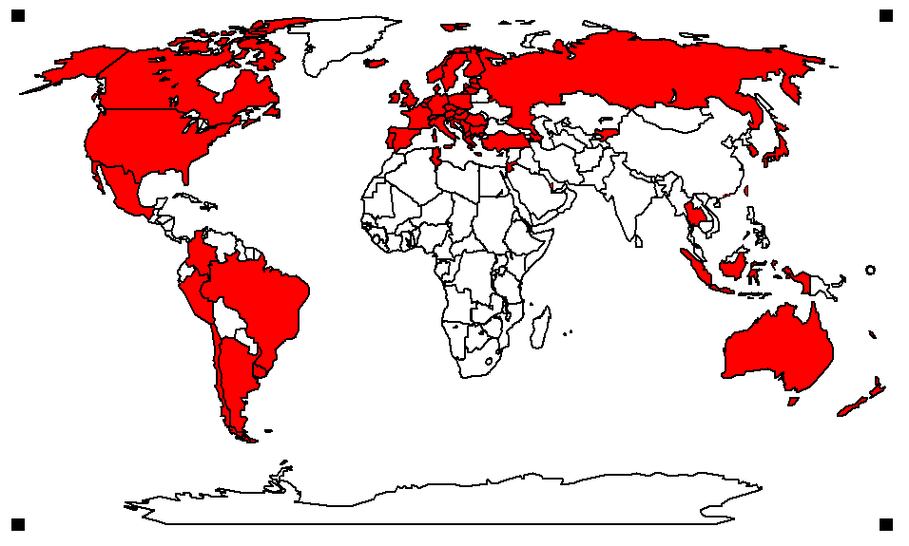
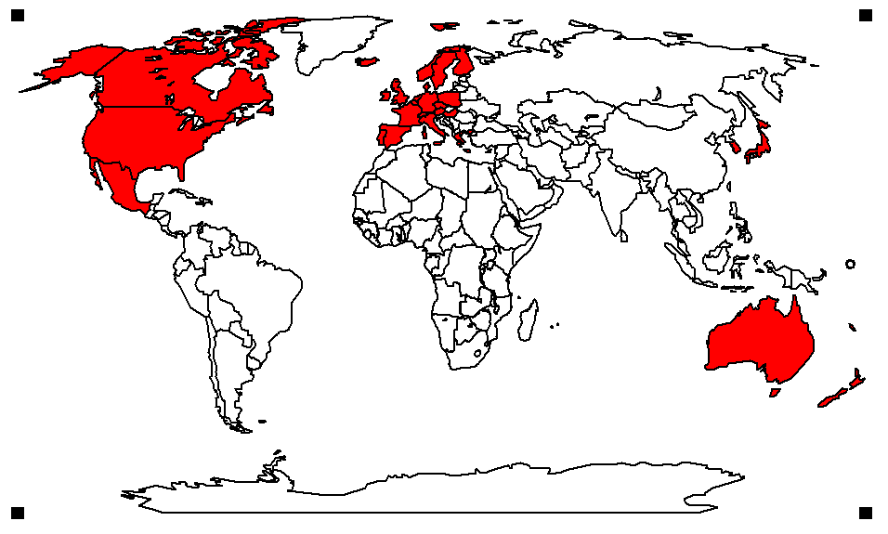
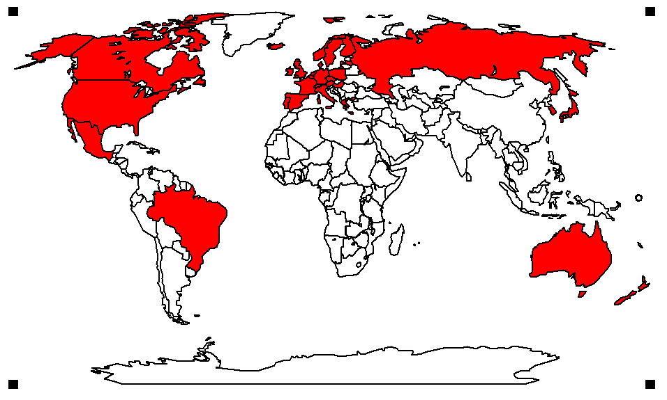


Key principles of PISA
PISA countries in
2003
2000
2001
2006
2009
1998
  ‘Crowd sourcing’ and collaboration
    PISA draws together leading expertise and institutions from participating countries to develop instruments and methodologies…
    … guided by governments on the basis of shared policy interests
  Cross-national relevance and transferability of policy experiences
    Emphasis on validity across cultures, languages and systems
    Frameworks built on well-structured conceptual understanding
    of assessment areas and contextual factors
  Triangulation across different stakeholder perspectives
    Systematic integration of insights from students, parents,
    school principals and system-leaders
  Advanced methods with different grain sizes
    A range of methods to adequately measure intended constructs with different grain sizes to serve different decision-making needs
    Productive feedback, at appropriate levels of detail, to fuel improvement at multiple levels .
Coverage of world economy
83%
77%
81%
85%
86%
87%
Notes:
We started to develop PISA in 1998 with 28 OECD countries, but since then country participation has grown and our latest PISA assessment covers 74 education systems that make up 86% of the world economy. Coverage in China and India is still patchy though, in China we have now covered 12 provinces and in India we are working in two states only.
One aspect that makes PISA stand apart from traditional school tests is that PISA puts less emphasis on whether students can reproduce what they were taught, but focuses on their capacity to extrapolate from what they know and creatively apply what they know in novel situations. Some people complain that PISA is unfair, because it confronts students with tasks they have not dealt with before, but if you take that line, then you should consider life unfair, because in this fast-changing world, that is precisely what will expect students later in life. You will see that in the callout box.
Students also provided data on their socio-economic context, their schools and their attitudes and engagement with school and learning.
In addition, PISA collected data from parents, principals and system leaders to yield insights on school policies, practices, resources and institutional factors that help explain performance differences.

Slide 5
The latest PISA assessment
PISA countries in
2003
2000
2001
2006
2009
1998
Coverage of world economy
83%
77%
81%
85%
86%
87%
Over half a million students…
  representing 28 million 15-year-olds in 74* countries/economies
… took an internationally agreed 2-hour test…
  Goes beyond testing whether students can
  reproduce what they were taught…
  … to assess students’ capacity to extrapolate from what they know and creatively apply their knowledge in novel situations
… and responded to questions on…
  their personal background, their schools
  and their engagement with learning and school
Parents, principals and system leaders provided data on…
  school policies, practices, resources and institutional factors that help explain performance differences .
  * Data for Costa Rica, Georgia, India, Malaysia, Malta, Mauritius, Venezuela and Vietnam will be published in December 2011
Notes:
We started to develop PISA in 1998 with 28 OECD countries, but since then country participation has grown and our latest PISA assessment covers 74 education systems that make up 86% of the world economy. Coverage in China and India is still patchy though, in China we have now covered 12 provinces and in India we are working in two states only.
One aspect that makes PISA stand apart from traditional school tests is that PISA puts less emphasis on whether students can reproduce what they were taught, but focuses on their capacity to extrapolate from what they know and creatively apply what they know in novel situations. Some people complain that PISA is unfair, because it confronts students with tasks they have not dealt with before, but if you take that line, then you should consider life unfair, because in this fast-changing world, that is precisely what will expect students later in life. You will see that in the callout box.
Students also provided data on their socio-economic context, their schools and their attitudes and engagement with school and learning.
In addition, PISA collected data from parents, principals and system leaders to yield insights on school policies, practices, resources and institutional factors that help explain performance differences.

Slide 6

Mathematics in PISA
The real world
The mathematical World
Making the problem amenable to mathematical treatment
A model of reality
A mathematical
model
Understanding, structuring and simplifying the situation
Using relevant mathematical tools to solve the problem
A real situation
Validating
the results
Real results
Mathematical
results
Interpreting
the mathematical results

Slide 7
The PISA framework
Domain 1
Domain 2
Domain 3
Outputs and Outcomes
impact of learning
Policy Levers
shape educational outcomes
Antecedents
contextualise or constrain ed policy
Level
A
Individual learner
Quality and distribution of knowledge & skills
Individ attitudes, engagement and behaviour
Socio-economic background of learners
Level
B
Instructional settings
Quality of instructional delivery
Teaching, learning practices and classroom climate
Student learning, teacher working conditions
Level
C
Schools, other institutions
Output and performance of institutions
The learning environment at school
Community
and school characteristics
Level
D
Country or system
Social & economic outcomes of education
Structures, resource alloc
and policies
National educ, social and economic context

Slide 8
School performance and socio-economic background
Mexico
600
493
Student performance
Private school
Public school in rural area
Public school in urban area
200
Disadvantage
PISA Index of socio-economic background
Advantage
Notes:
Countries at the bottom of the league tend to be suspicious about those high performing countries because the kind of policies you need to activate to get from good to great are very different than what you need to move from poor to adequate. But even if you don’t want to change your system, there is a lot that PISA shows you can learn from the most successful schools in your own system.
Let us use the horizontal axis to represent the social background of students and schools and the vertical axis to show the performance of schools. Now you can show where each school in Mexico stands with regard to how well it does and the socio-economic conditions under which it works. The first thing you see is that there is a relationship between social background and school performance. But you also see that there is lots of variability in school performance. Let us just look at a slice of schools that work under similarly disadvantaged social conditions.
You see that some of them do very well even by OECD standards while others do quite poorly. If Mexican schools would achieve what Mexican schools show can be achieved, Mexico’s overall performance would be significantly higher. Similarly, you can look at the schools where rich parents sent their children, all marked in green which tells you that these are private schools. But not all of them are of good quality.

Slide 9
The challenge of PISA for Development
Can we develop a framework that embraces the diversity of contexts in which students learn, teachers teach and school systems operate?
  As comparable as possible to facilitate peer-learning
  As country-specific as necessary to be meaningful and interpretable in national contexts
Can we extend measurement to children not enrolled in formal education?
  Establishing policy-incentives for inclusiveness
Can we improve the relevance, quality and reliability of performance measurement?
  Establishing measures that work in a wider range of countries

Slide 10

Thank you !
  Find out more about PISA at…
  OECD www.pisa.oecd.org
    All national and international publications
    The complete micro-level database
  Email: Andreas.Schleicher@OECD.org
  … and remember:
  Without data, you are just another person with an opinion

